Slide 1
Building ML Apps with Streamlit
DIRISA Datathon | Instructor: Kgaugelo Mmakola

Slide 2
What is Streamlit?
A Python framework for building interactive web apps quickly
Ideal for data science and machine learning
Runs in the browser with just a Python script

Slide 3
Why Use Streamlit?
Turns Python scripts into apps with no HTML/CSS/JS
Great for sharing ML models with users
Supports live inputs, charts, media, and file upload

Slide 4
Basic Streamlit Workflow
Import Streamlit and required libraries
Load your trained model (e.g., joblib.load)
Create input fields (text, numbers, etc.)
Predict using the model
Display the result

Slide 5
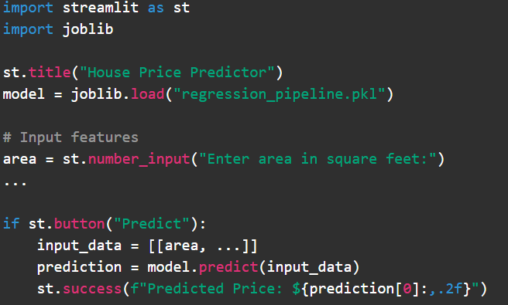
Example - Regression App

Slide 6
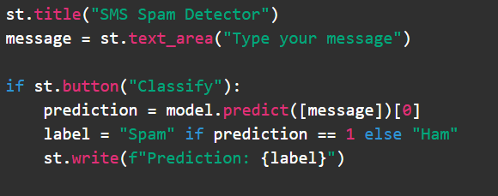
Example - Text Classification App

Slide 7
Deployment Tips
Run locally with streamlit run app.py
Deploy with platforms like Streamlit Cloud, Render, or Heroku
Save your model and load it inside the app

Slide 8
Summary
Streamlit lets you create simple ML apps fast
Works well with Scikit-learn pipelines
Great for demoing and deploying your models

Slide 9
Thank you!!

